Slide 1

8th Grade Math: Pre-Algebra
Unit 6, Lesson 1 Proportional Relationships Volume 1, pg. 237

Slide 2


Benchmark
MA.8.AR.3.1
Determine if a linear relationship is also a proportional relationship.
volume 1, pg. 237

Slide 3
Integrated Mathematical Thinking and Reasoning Standards
MA.K12.MTR.1.1 Actively participate in effortful learning both individually and collectively.
MA.K12.MTR.2.1 Demonstrate understanding by representing problems in multiple ways.
MA.K12.MTR.4.1 Engage in discussions that reflect on the mathematical thinking of self and others.
MA.K12.MTR.5.1 Use patterns and structure to help understand and connect mathematical concepts.
MA.K12.MTR.6.1 Assess the reasonableness of solutions.
MA.K12.MTR.7.1 Apply mathematics to real-world contexts.
volume 1, pg. 237

Slide 4

Learning Target
I can describe attributes of a proportional relationship between two variables represented by tables and equations.
volume 1, pg. 237

Slide 5

Warm-Up
volume 1, pg. 237

Slide 6

6.1.1 Warm-Up: Day at Work – Bridge Builder
Ken Brown said, “You are hammered all through school to think, and the thinking part is a big part of your education where you are taught how to think and solve problems.”
Why is learning how to think and solve problems important for any job you do in the future?
volume 1, pg. 237

Slide 7

Exploration
volume 1, pg. 238

Slide 8

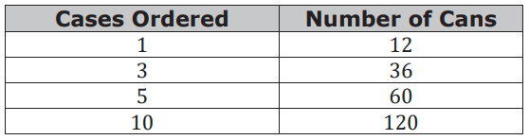
6.1.2 Exploration: What Is a Proportional Relationship?
The table shows how many cans of disinfectant spray a hospital receives depending on the number of cases ordered.
How many cans are in each separate case when 3 cases are ordered?
volume 1, pg. 238

Slide 9
How many cans are in each case when 5 cases are ordered?
How many cans are in each case when 10 cases are ordered?
volume 1, pg. 238

Slide 10
Explain how to determine the number of cans of disinfectant spray that would be in each separate case when ordering any number of cases.
This situation represents a proportional relationship. Discuss with your partner why the situation is a proportional relationship and summarize your conclusions.
volume 1, pg. 238

Slide 11

Guided Instruction
volume 1, pg. 239

Slide 12

6.1.3 Guided Instruction: Understanding Proportional Relationships
A proportional relationship is a collection of pairs of numbers that are in equivalent ratios.
volume 1, pg. 239

Slide 13
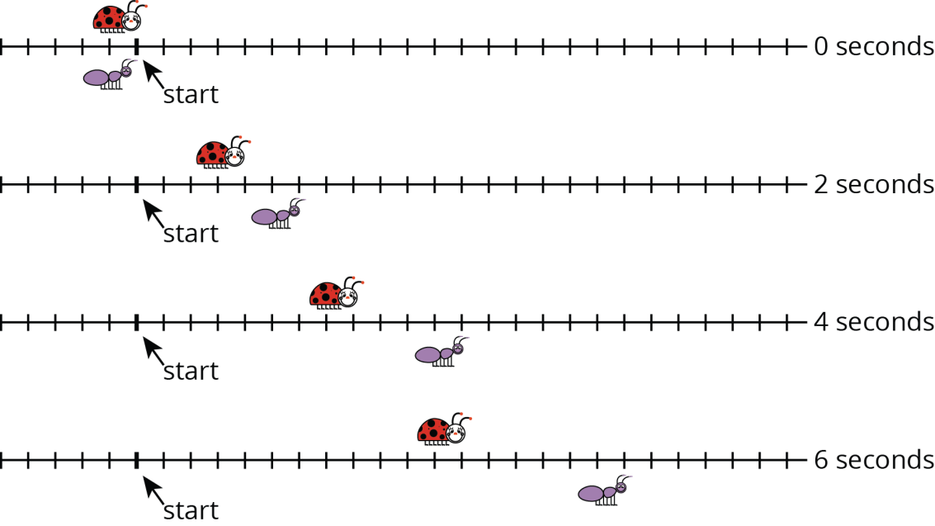
A ladybug and an ant move at constant speeds. The diagram with tick marks shows their positions at different times, in seconds (sec). Each tick mark represents 1 centimeter (cm).
volume 1, pg. 239

Slide 14
Complete the table of values for the ladybug and the ant.
One way to determine if a relationship is proportional is to identify if ______________________ ratios exist.
Ladybug
Time (sec) | Distance (cm)
0 | 0
2
4
6
Ant
Time (sec) | Distance (cm)
0 | 0
2
4
6
volume 1, pg. 239

Slide 15
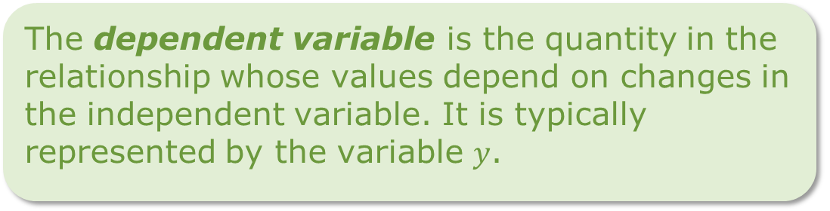
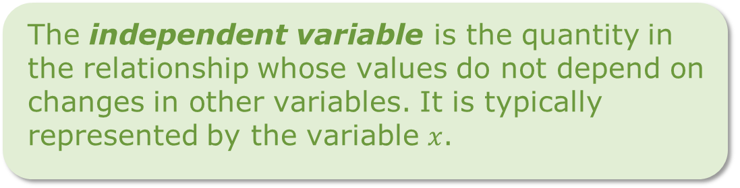

When writing ratios for situations with two variables, each ratio should compare the dependent variable to the independent variable and can be written in fractional form as $\frac{dependent variable}{independent variable}$.
The independent variable is the quantity in the relationship whose values do not depend on changes in other variables. It is typically represented by the variable $x$.
The dependent variable is the quantity in the relationship whose values depend on changes in the independent variable. It is typically represented by the variable $y$.
volume 1, pg. 239

Slide 16
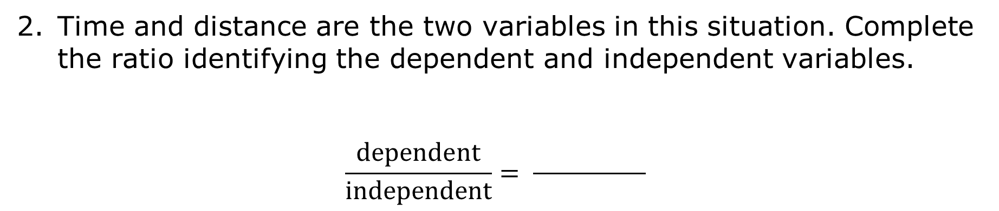
Time and distance are the two variables in this situation. Complete the ratio identifying the dependent and independent variables.
$$\frac{dependent}{independent}= \frac{ }{ }$$
volume 1, pg. 239

Slide 17
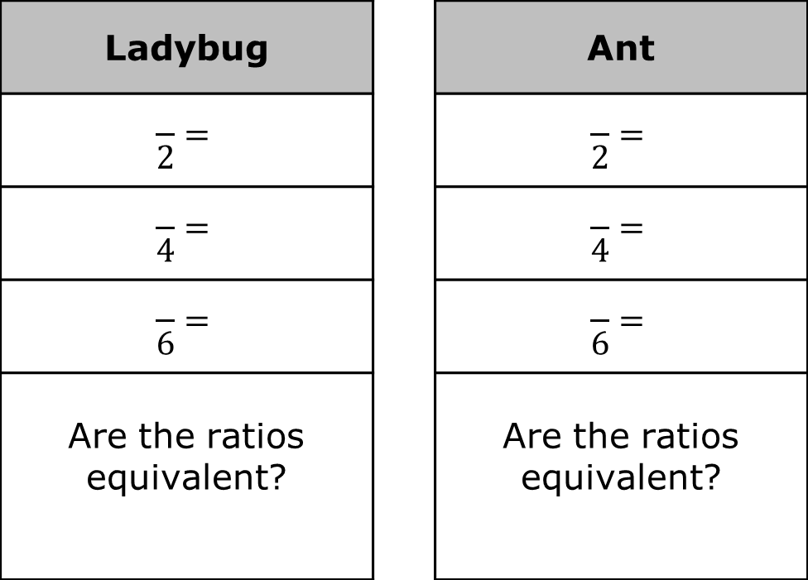
Complete the set of ratios for each insect and determine if the ratios within each set are equivalent.
Ladybug |  | Ant
$$\frac{ }{2}=$$ |  | $$\frac{ }{2}=$$
$$\frac{ }{4}=$$ |  | $$\frac{ }{4}=$$
$$\frac{ }{6}=$$ |  | $$\frac{ }{6}=$$
Are the ratios equivalent? |  | Are the ratios equivalent?
volume 1, pg. 240

Slide 18
Explain how you know if the tables each represent a proportional relationship.
Discuss with your partner why the ratio, when time is equal to zero, is not determined for each situation and summarize your conclusions.
volume 1, pg. 240

Slide 19



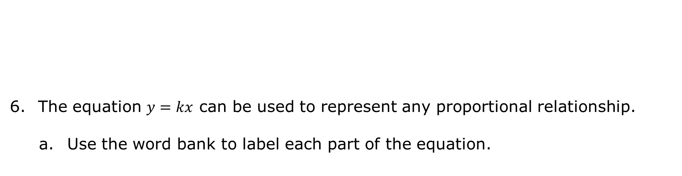
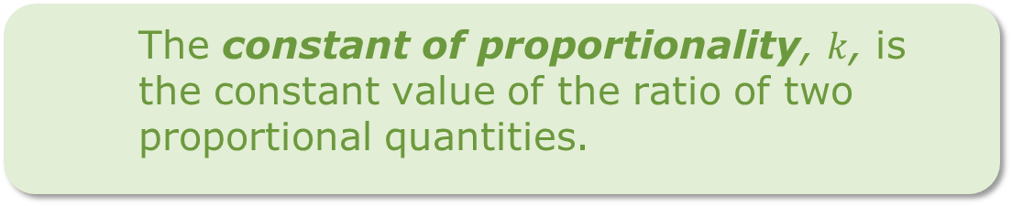
The equation $y=kx$ can be used to represent any proportional relationship.
Use the word bank to label each part of the equation.
The constant of proportionality, $k$, is the constant value of the ratio of two proportional quantities.
volume 1, pg. 240

Slide 20
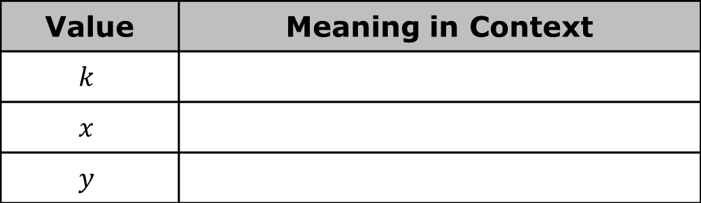
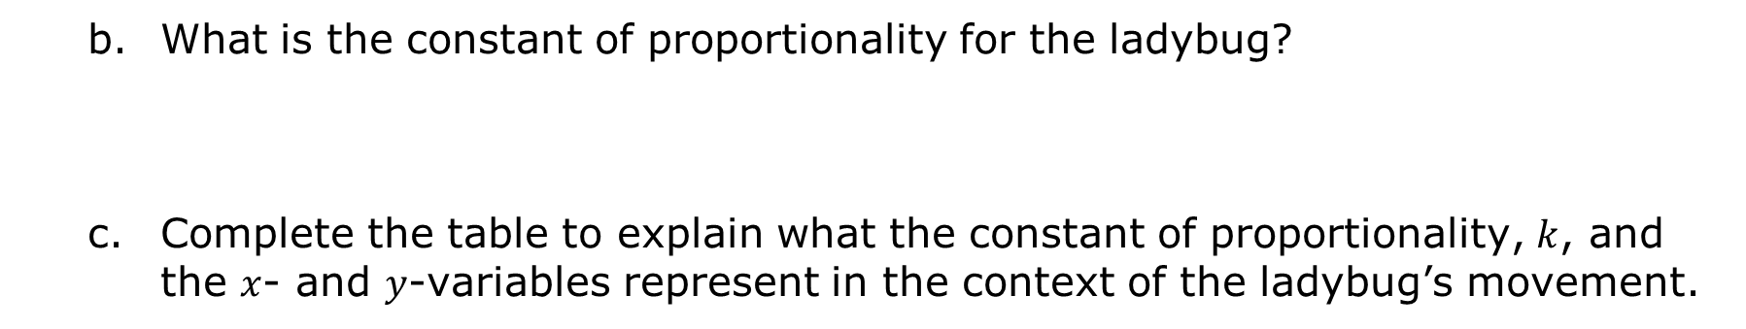
What is the constant of proportionality for the ladybug?
Complete the table to explain what the constant of proportionality, $k$, and the $x$- and $y$-variables represent in the context of the ladybug’s movement.
Value | Meaning in Context
$$k$$
$$x$$
$$y$$
volume 1, pg. 240

Slide 21
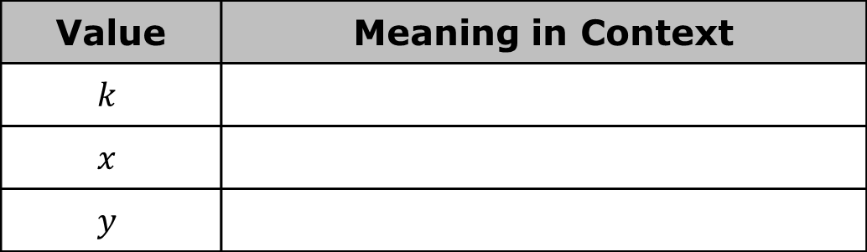
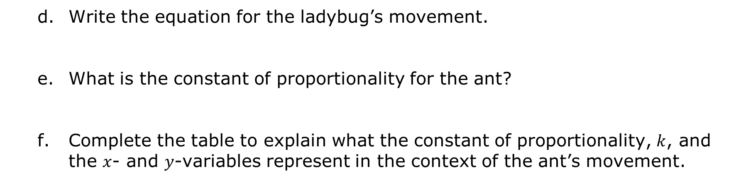
Write the equation for the ladybug’s movement.
What is the constant of proportionality for the ant?
Complete the table to explain what the constant of proportionality, $k$, and the $x$- and $y$-variables represent in the context of the ant’s movement.
Value | Meaning in Context
$$k$$
$$x$$
$$y$$
volume 1, pg. 241

Slide 22
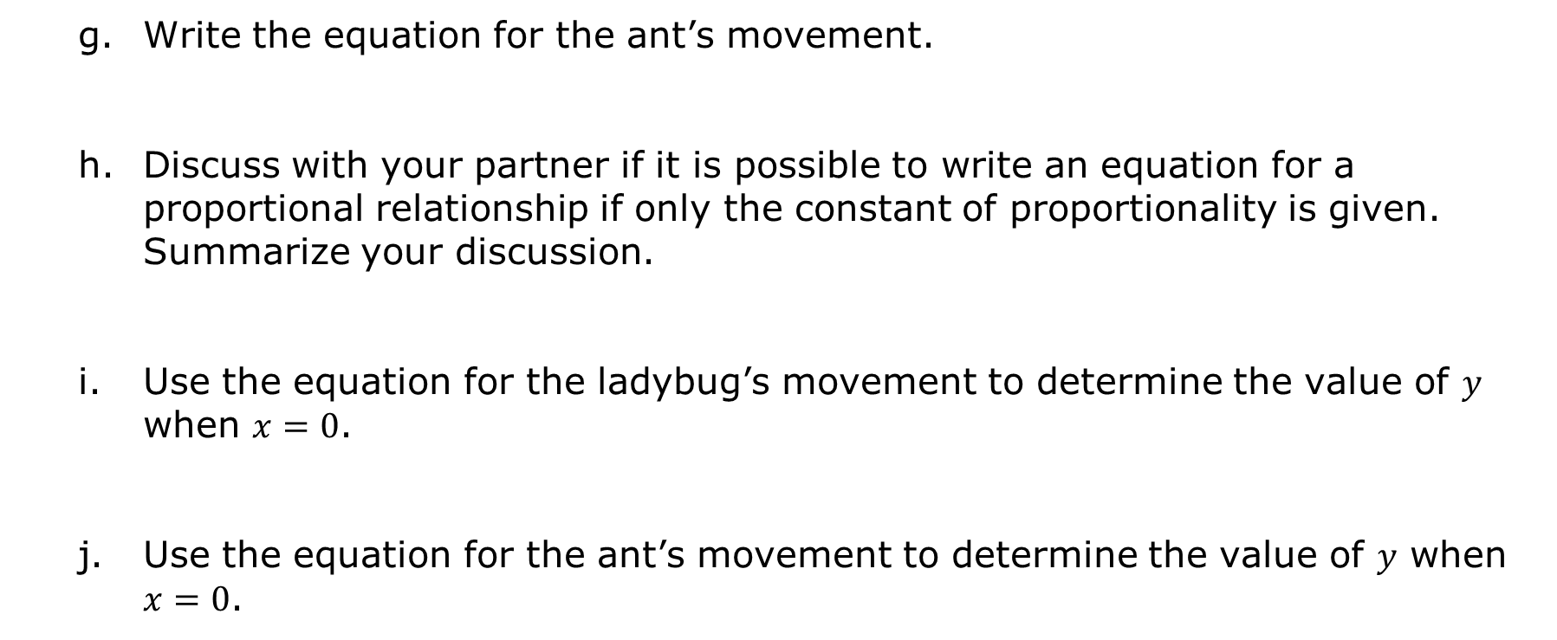
Write the equation for the ant’s movement.
Discuss with your partner if it is possible to write an equation for a proportional relationship if only the constant of proportionality is given. Summarize your discussion.
Use the equation for the ladybug’s movement to determine the value of $y$ when $x=0$.
Use the equation for the ant’s movement to determine the value of $y$ when $x=0$.
volume 1, pg. 241

Slide 23
Use the equation $y=k∙x$ to explain why the value of $y$ will be $0$ when $x=0$ no matter the value of constant of proportionality, $k$.
volume 1, pg. 241

Slide 24

Wrap-Up
volume 1, pg. 242

Slide 25
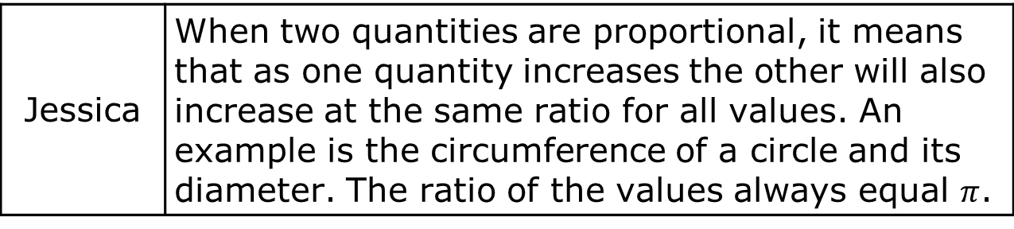
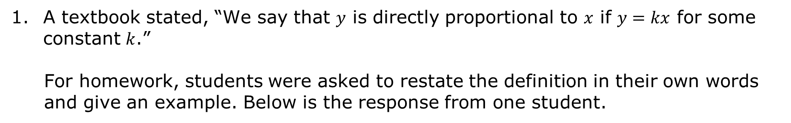
6.1.4 Wrap-Up: Cool Down
A textbook stated, “We say that $y$ is directly proportional to $x$ if $y=kx$ for some constant $k$.”
For homework, students were asked to restate the definition in their own words and give an example. Below is the response from one student.
Jessica | When two quantities are proportional, it means that as one quantity increases the other will also increase at the same ratio for all values. An example is the circumference of a circle and its diameter. The ratio of the values always equal $π$.
volume 1, pg. 242

Slide 26
Write your own definition and example, including how to recognize a proportional relationship from a table and an equation.
Name | Definition & Example
volume 1, pg. 242

